Slide 1

Crypto API investigation
Renesas Electronics corporation
Feb, 2023
Notes:
Today I am going to present the latest updates from FSP, what is going on at the RA SW side!!

Slide 2
agenda
I. Cryptography
II. Azure RTOS NetX Crypto HW Acceleration (rm_netx_secure_crypto)
III. Mbed Crypto HW Acceleratio
IV. Secure Crypto Engine
V. AES algorithm

Slide 3

I. CRyptography
Reference: (85) What is Cryptography? | Introduction to Cryptography | Cryptography for Beginners | Edureka - YouTube

Slide 4
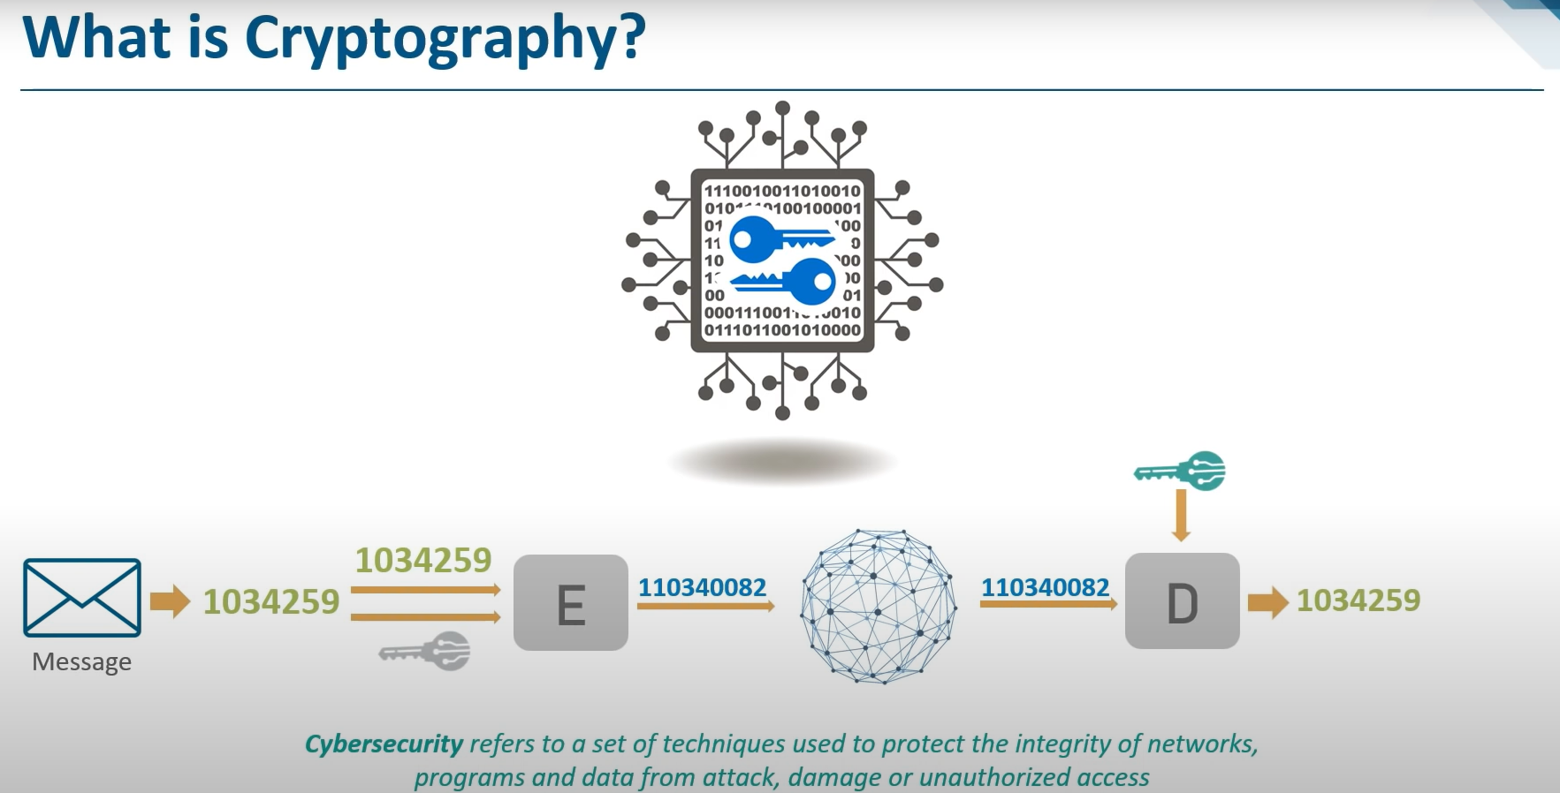
I. CRyptography

Slide 5
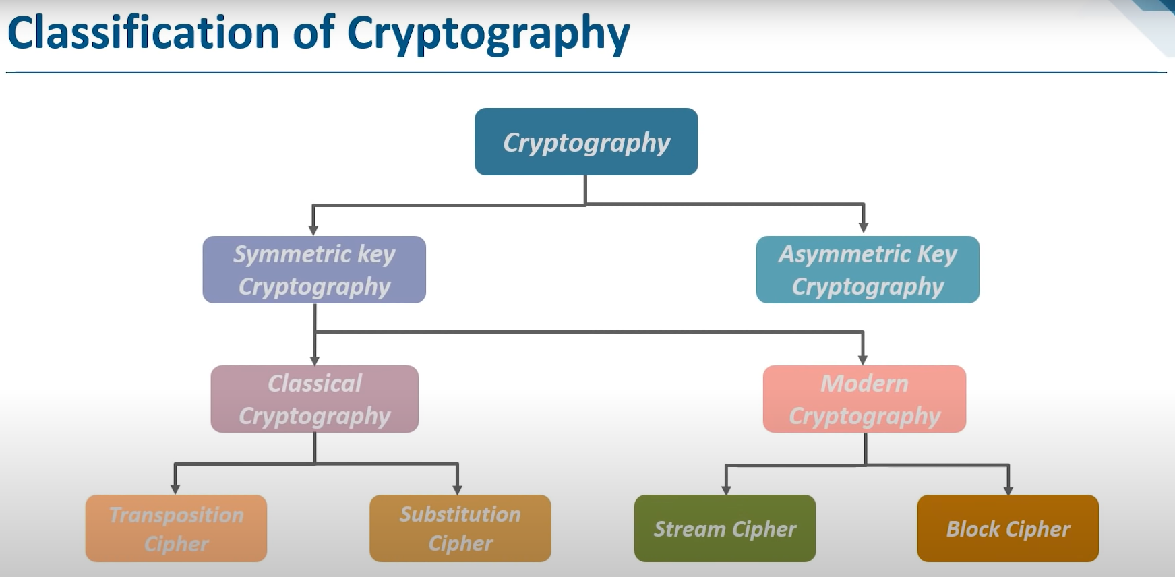
I. CRyptography

Slide 6
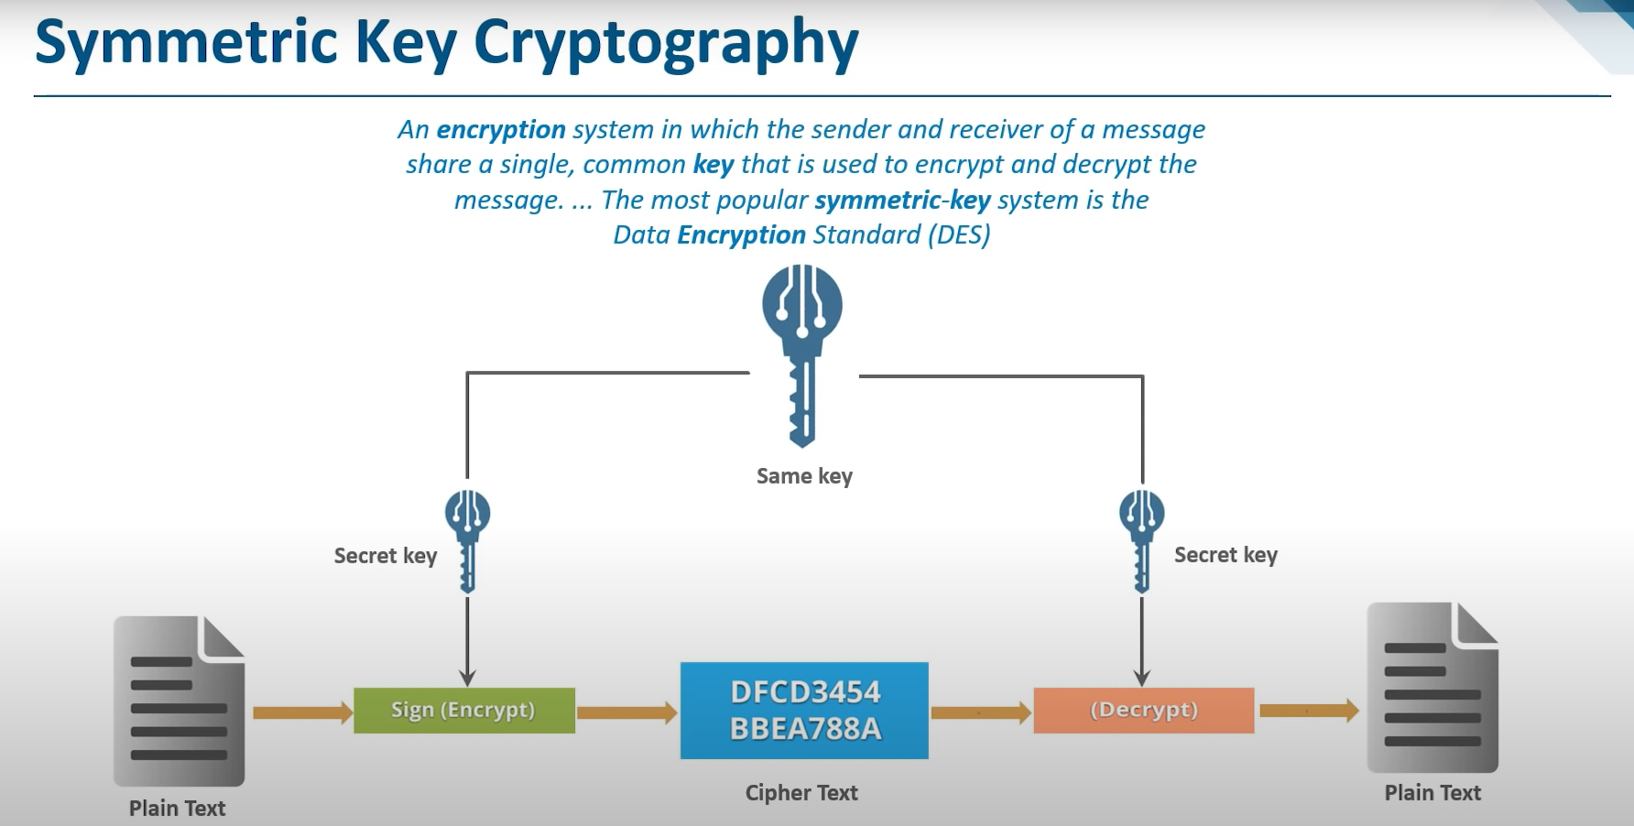
I. CRyptography

Slide 7
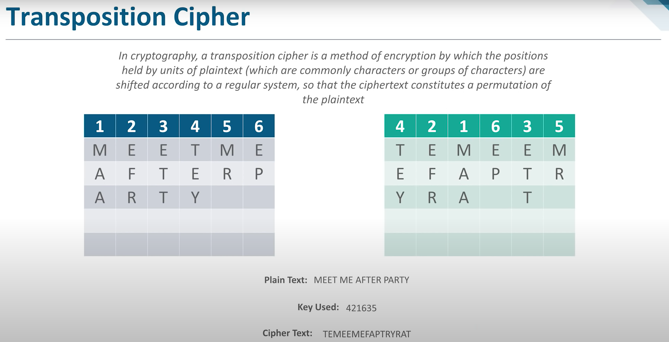
I. CRyptography

Slide 8
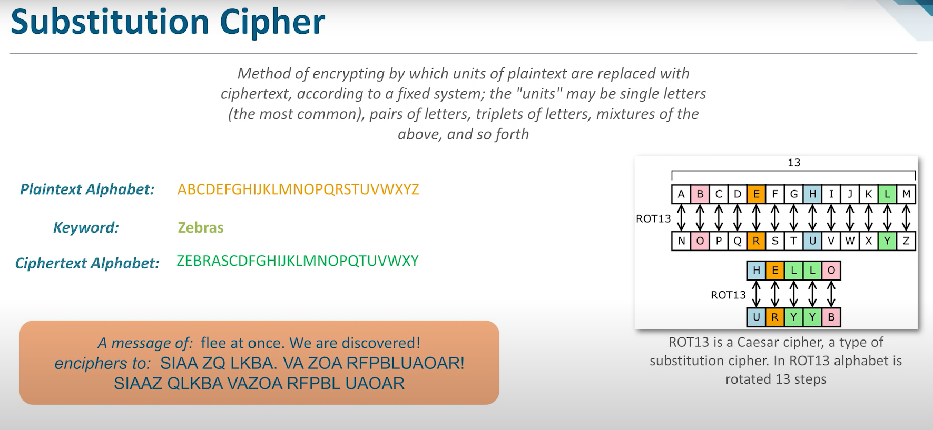
I. CRyptography

Slide 9
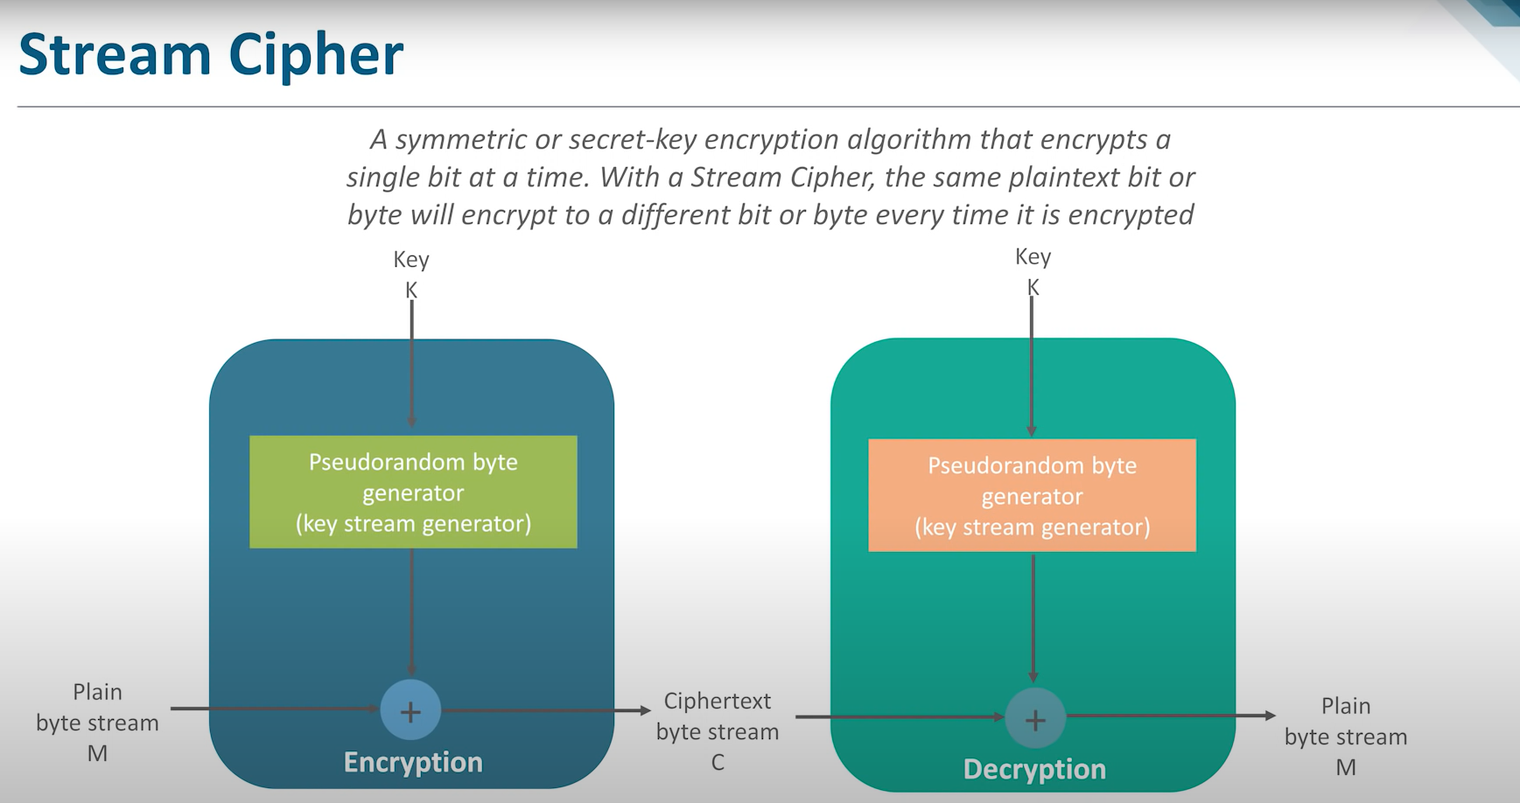
I. CRyptography

Slide 10
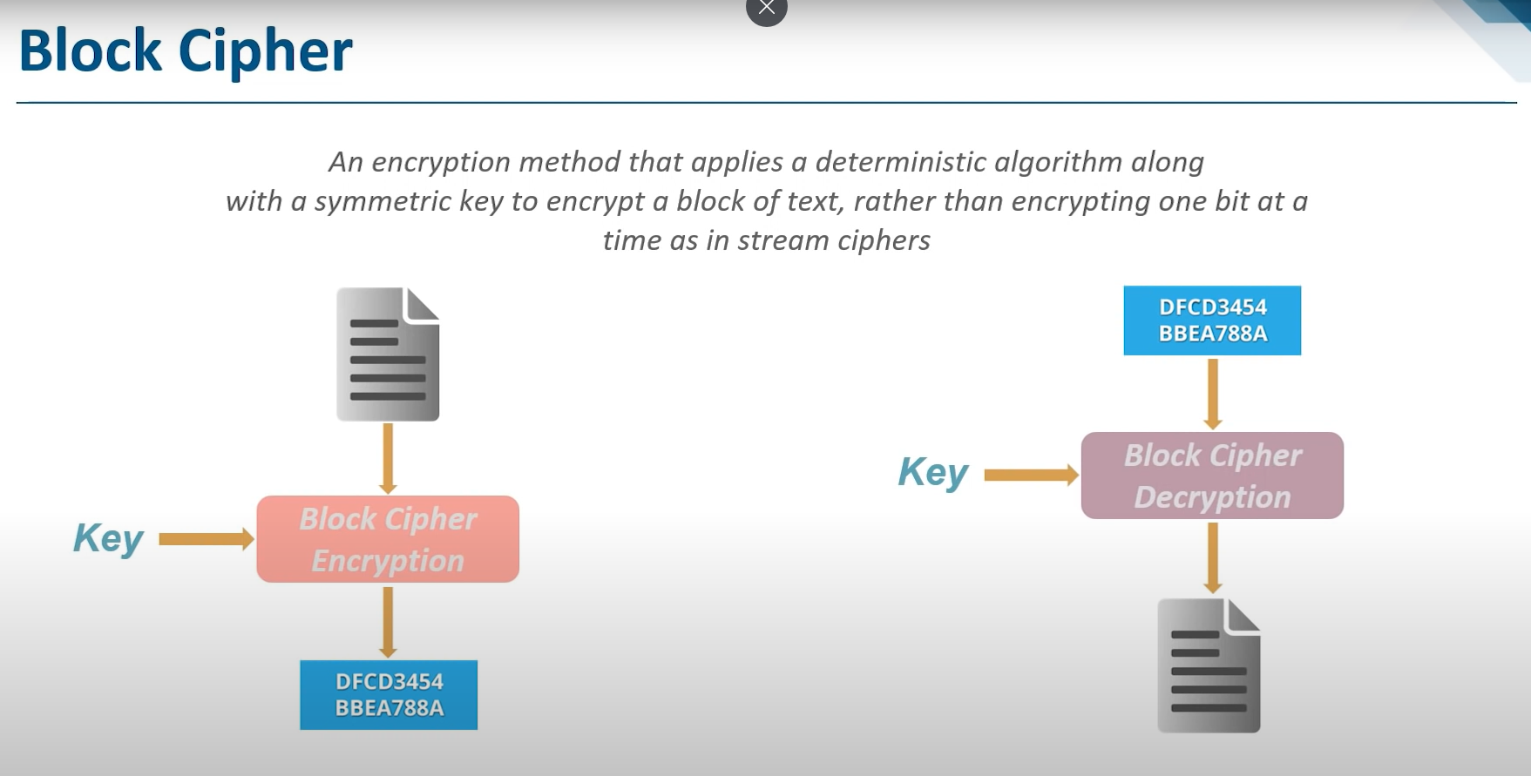
I. CRyptography

Slide 11
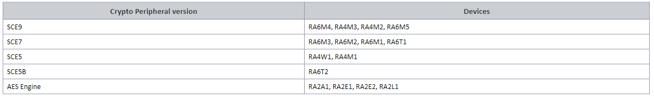
ii. Azure RTOS NetX Crypto HW Acceleration 2.1 NetX Crypto Unique Features
RA FSP Document: RA Flexible Software Package Documentation: Azure RTOS NetX Crypto HW Acceleration (rm_netx_secure_crypto) (renesas.github.io)
Hardware acceleration for the Netx Crypto implementation of the Microsoft Azure RTOS NetX Crypto API. (Overview for this is in next page)
HW Overview:
Note: NetX Crypto hardware acceleration is unsupported on 'SCE5' and 'AES Engine' crypto peripherals listed above.

Slide 12
ii. Azure RTOS NetX Crypto HW Acceleration 2.2 Microsoft Azure RTOS NetX Crypto API
Azure RTOS NetX Crypto is a high-performance real-time implementation of cryptographic algorithms designed to provide data encryption and authentication services
NetX Crypto Unique Features
NetX Crypto is implemented in the standard C language (C99), compatible with virtually all C/C++ compilers
All these operations are used with 32-bit quantities, making NetX Crypto portable across most 32-bit microprocessors.
The implementation is specifically optimized to run on resource constrained microprocessors, targeting deeply embedded applications

Slide 13
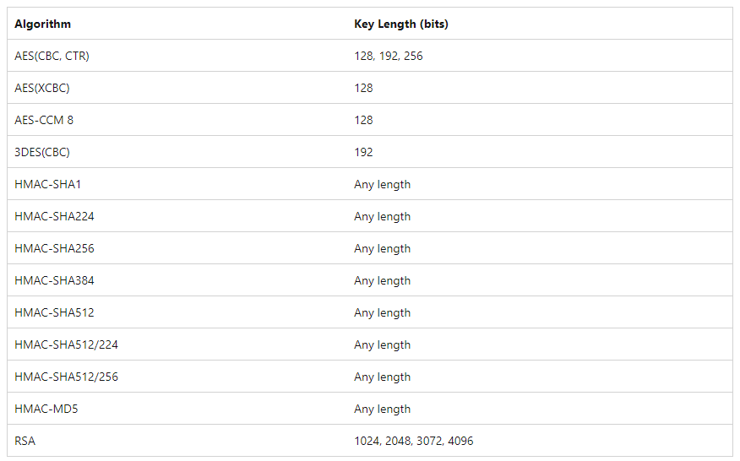
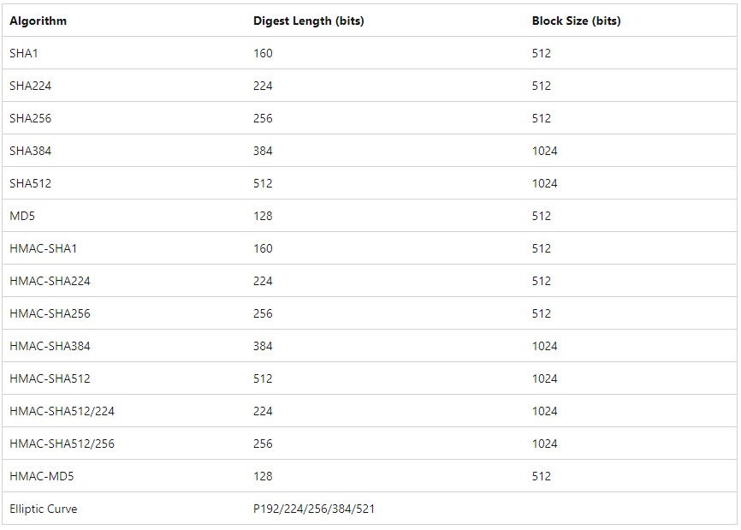
ii. Azure RTOS NetX Crypto HW Acceleration 2.2 Microsoft Azure RTOS NetX Crypto API
NetX Crypto supports the following cryptographic algorithms

Slide 14
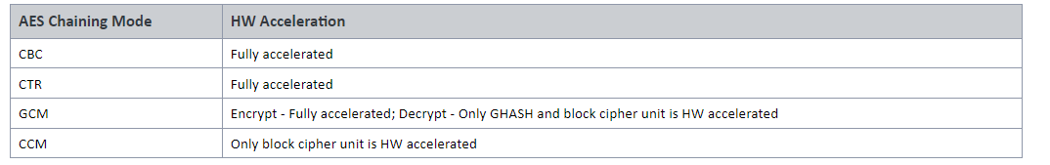
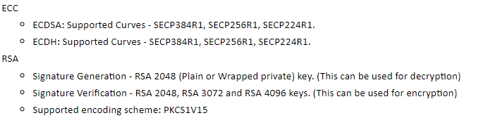
ii. Azure RTOS NetX Crypto HW Acceleration 2.3 features
This module provides SCE9 hardware support for the following NetX Crypto operations
SHA224 calculation
SHA256 calculation
MAC Operations
AES
ECC
Random number generation
RSA
HMAC with SHA224
Keybits - 128, 192, 256
- Encryption and Decryption.
- Chaining Modes: CBC, CTR, GCM mode
HMAC with SHA256

Slide 15
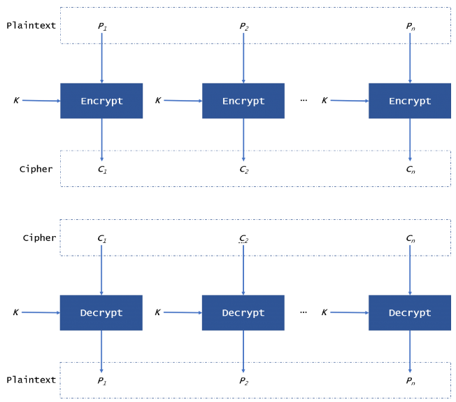
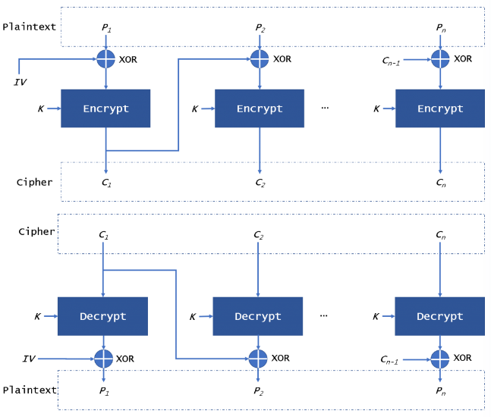
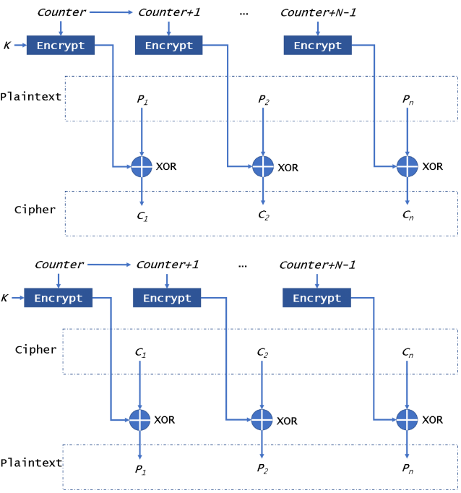
Note: AES chaining mode
ECB (Electronic Code Book) mode
CTR (Counter) mode
CBC (Cipher Block Chaining) mode
Link: The difference in five modes in the AES encryption algorithm - Highgo Software Inc.

Slide 16
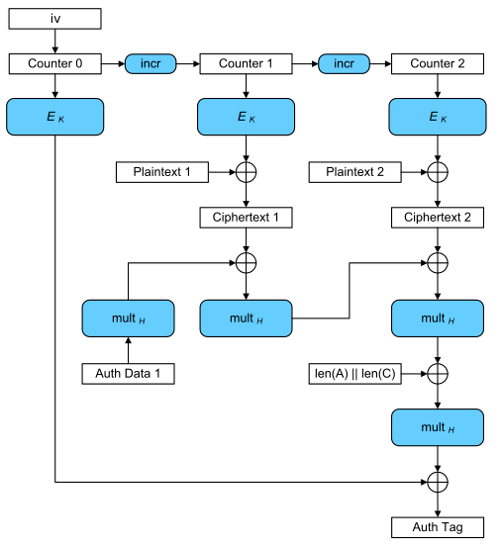
Note: AES chaining mode
AES-GCM
AES-CCM

Slide 17
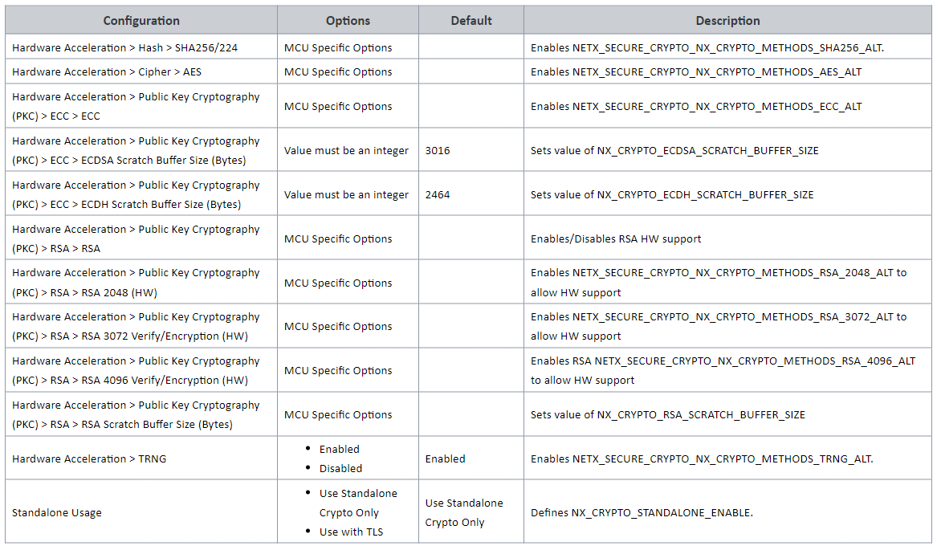
ii. Azure RTOS NetX Crypto HW Acceleration 2.4 Configuration
Build Time Configurations for rm_netx_secure_crypto:

Slide 18
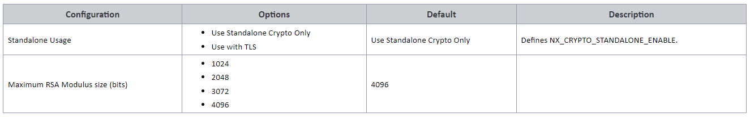
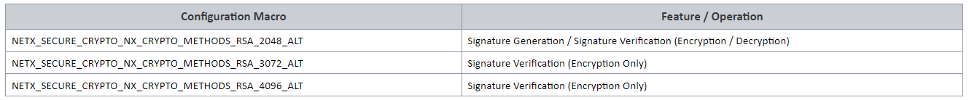
ii. Azure RTOS NetX Crypto HW Acceleration 2.4 Configuration
Build Time Configurations for rm_netx_secure_crypto_sw_port (in fsp_cfg/middleware/rm_netx_secure_crypto_cfg.h):
Random Number Generator Configuration: NETX_SECURE_CRYPTO_NX_CRYPTO_METHODS_TRNG_ALT must be defined
SHA256 Configuration: To enable hardware acceleration for the SHA256/224 calculation, the macro NETX_SECURE_CRYPTO_NX_CRYPTO_METHODS_SHA256_ALT must be defined
AES Configuration: To enable hardware acceleration for the AES128/192/256 operation, the macro NETX_SECURE_CRYPTO_NX_CRYPTO_METHODS_AES_ALT must be defined
ECC Configuration: To enable hardware acceleration for the ECDSA and ECDH for curves SECP384R1, SECP256R1 and SECP224R1, the macro NETX_SECURE_CRYPTO_NX_CRYPTO_METHODS_ECC_ALT must be defined
RSA Configuration: To enable hardware acceleration for the RSA Encrypt/Decrypt (or Sign/Verify) operation(s), the macro(s) below must be must be defined

Slide 19
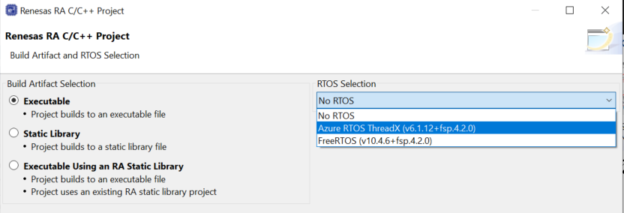
ii. Azure RTOS NetX Crypto HW Acceleration 2.4 Usage note
Hardware Initialization: _nx_crypto_initialize() must be invoked before using the NetX Crypto APIs to ensure that the SCE peripheral is initialized.
AES Usage: GCM mode
The first byte of the IV must indicate the length of the subsequent IV.
(Please refer this document for detail: https://renesas.github.io/fsp/group___r_m___n_e_t_x___s_e_c_u_r_e___c_r_y_p_t_o.html )
Limitations:
Only little endian mode is supported.
RSA CRT keys are not supported.
ECJPAKE related operations are unsupported for NIST 224, 256 and 384 bit curves when HW ECC is enabled.
Note:
Notes:
Little endian và big endian, đây là hai phương thức khác nhau để lưu trữ dữ liệu dạng nhị phân

Slide 20
iii. Mbed Crypto HW Acceleration 3.1 History
The Mbed cryptography library is a reference implementation of the cryptography interface of the Arm’s Platform Security Architecture (PSA)
PSA cryptography API:
+ Arm's Platform Security Architecture (PSA) is a holistic set of threat models, security analyses, hardware and firmware architecture specifications, and an open source firmware reference implementation.
+ PSA provides a recipe, based on industry best practice, that allows security to be consistently designed in, at both a hardware and firmware level.
The design goals of the PSA cryptography API:
+ The API distinguishes caller memory from internal memory, which allows the library to be implemented in an isolated space for additional security.
+ The structure of internal data is hidden to the application, which allows substituting alternative implementations at build time or run time.
+ All access to the keys happens through handles, which allows support for external cryptoprocessors that is transparent to applications.
+ The interface to algorithms is generic, favoring algorithm agility.
+ The interface is designed to be easy to use and hard to accidentally misuse.
Note: The PSA Crypto module does not provide any interfaces to the user. This release uses the mbedTLS version 3.2.1 which conforms to the PSA Crypto API 1.0 specification

Slide 21
iii. Mbed Crypto HW Acceleration 3.2 psa crypto api
The interface is user-friendly, while still providing access to the low-level primitives used in modern cryptography
Design goals:
Suitable for vast range of device.
A keystore interface: The specification allows cryptographic operations to be performed on a key to which the application does not have direct access.
Optional isolation: Implementations can isolate the cryptoprocessor from the calling application, and can further isolate multiple calling applications.
Choice of algorithms: The specification defines a low-level cryptographic interface, where the caller explicitly chooses which algorithm and which security parameters they use.
Ease of use: The interface is designed to be as user-friendly as possible, given the aforementioned constraints on suitability for various types of devices and on the freedom to choose algorithms.
Link: 2. Design goals — PSA Crypto API 1.0.1 documentation (armmbed.github.io)
Notes:
A keystore interface: API cho phép hoạt động mã hóa thực hiện với một key mà app ko thể access trực tiếp.
Optional isolation: API có thể cô lập cryptoprocessor với app calling và hơn thế nữa

Slide 22
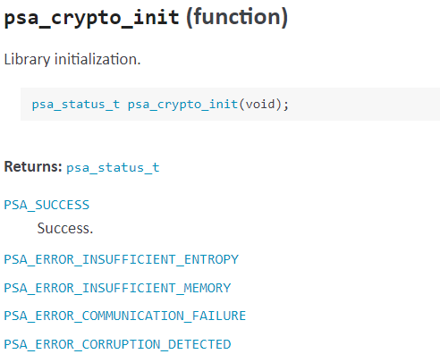
3.2 psa crypto api - Functionality overview 3.2.1 Library management
Applications must call psa_crypto_init() to initialize the library before using any other function.
Applications are permitted to call this function more than once. Once a call succeeds, subsequent calls are guaranteed to succeed.
In case, If the application calls any function that returns a psa_status_t result code before calling psa_crypto_init(), please refer 8.2. PSA Crypto library — PSA Crypto API 1.1.0 documentation (armmbed.github.io)

Slide 23
3.2 psa crypto api - Functionality overview 3.2.2 Key management
Applications always access keys indirectly via an identifier, and can perform operations using a key without accessing the key material.
Each key has a set of attributes that describe the key and the policy for using the key. A psa_key_attributes_t object contains all of the attributes, which is used when creating a key and when querying key attributes.
Key types
Each cryptographic algorithm requires a key that has the right form, in terms of the size of the key material and its numerical properties. The key type and key size encode must compatible with a cryptographic algorithm.
Key identifiers
The lifetime of a key indicates where it is stored and which application and system actions will create and destroy it.
Key lifetimes
Key identifiers are output from a successful call to one of the key creation functions.
Key policies
All keys have an associated policy that regulates which operations are permitted on the key. Each key policy is a set of usage flags and a specific algorithm that is permitted with the key.
Valid key identifiers must have distinct values within the same application. If the implementation provides caller isolation, then key identifiers are local to each application.
There are two main types of lifetimes: volatile and persistent.
Notes:
Key types: Mỗi cryptographic algorithm cần key đúng form,
Key identifiers: đây là output nếu call key creation success. Trong cũng app thì key identifier là duy nhất
Key lifetimes: chỉ định nơi lưu trữ key và app + system action nào sẽ được tạo.
Key polidies: là một bộ các flag và thuật toán được phép dùng

Slide 24
3.2. psa crypto api - Functionality overview 3.2.2 Key management
Recommendations of minimum standards for key management: Most implementations provide the following functions:
psa_import_key(). The exceptions are implementations that only give access to a key or keys that are provisioned by proprietary means, and do not allow the main application to use its own cryptographic material.
psa_get_key_attributes() and the psa_get_key_xxx() accessor functions. They are easy to implement, and it is difficult to write applications and to diagnose issues without being able to check the metadata.
psa_export_public_key(). This function is usually provided if the implementation supports any asymmetric algorithm, since public-key cryptography often requires the delivery of a public key that is associated with a protected private key.
psa_export_key(). However, highly constrained implementations that are designed to work only with short-term keys, or only with long-term non-extractable keys, do not need to provide this function

Slide 25
3.2 psa crypto api - Functionality overview 3.2.3 Symmetric cryptography
MAC is used to authenticate the origin and nature of a message. MACs use authentication cryptography to verify the legitimacy of data sent through a network or transferred from one person to another.
This specification defines interfaces for the following types of symmetric cryptographic operation:
Message digests, commonly known as hash functions
Message authentication codes (MAC)
Symmetric ciphers
Key derivation.
Authenticated encryption with associated data (AEAD)
Link

Slide 26
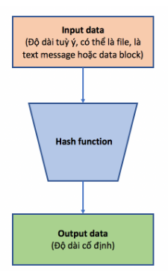
Note 1 - hash
Hash function hay còn gọi là “hàm băm” là hàm nhận một input đầu vào, từ input đó tạo ra một giá trị output (hay còn gọi là “hash value” – “giá trị băm”) tương ứng. Giá trị đầu vào có thể có độ dài tuỳ ý nhưng giá trị băm thì luôn có độ dài cố định. Hash function là hàm mã hoá một chiều.
Một hash function tốt phải thỏa mãn các điều kiện sau
Tính toán nhanh
Ít xảy ra đụng độ, tức là khả năng để các gía trị input khác nhau cho ra cùng một giá trị
băm là rất thấp
Không thể đảo ngược: Đảm bảo không có phương pháp khả thi để tính toán được dữ liệu
vào nào đó để cho ra giá trị băm mong muốn
Một số hash function phổ biến: MD5, Secure Hash Function (SHA), CRC232, RIPEMD, Whirlpool
Notes:
In this session, I will go through the overview of recent FSP releases, new features released in FSP, features that are in development and planned features and finally the FSP roadmap.

Slide 27
3.2 psa crypto api - Functionality overview 3.2.3 Asymmetric cryptography
This specification defines interfaces for the following types of symmetric cryptographic operation:
Asymmetric encryption (also known as public key encryption)
Asymmetric signature.
Two-way key agreement
Notes:
In this session, I will go through the overview of recent FSP releases, new features released in FSP, features that are in development and planned features and finally the FSP roadmap.

Slide 28
iii. Mbed Crypto HW Acceleration 3.3 Mbed Crypto impementation
Mbed Crypto is now the interface for crypto operations.
Working closely with Arm for improvements.
Mbed Crypto is a reference implementation of the PSA cryptography API. It is written in portable C.
RA FSP Document: RA Flexible Software Package Documentation: Mbed Crypto HW Acceleration (rm_psa_crypto) (renesas.github.io)
mbedcrypto-3.1.0 Github: GitHub - ARMmbed/mbed-crypto at mbedcrypto-3.1.0
Notes:
In this session, I will go through the overview of recent FSP releases, new features released in FSP, features that are in development and planned features and finally the FSP roadmap.

Slide 29
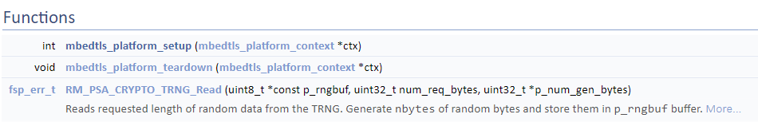
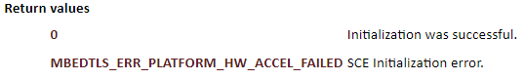
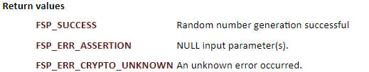
iii. Mbed Crypto HW Acceleration 3.4 functions
mbedtls_platform_setup(): This function initializes the SCE and the TRNG. It must be invoked before the crypto library can be used
mbedtls_platform_teardown(): It is intended to de-initialize any items that were initialized in the mbedtls_platform_setup() function
RM_PSA_CRYPTO_TRNG_Read(): Reads requested length of random data from the TRNG. Generate nbytes of random bytes and store them in p_rngbuf buffer.
Notes:
In this session, I will go through the overview of recent FSP releases, new features released in FSP, features that are in development and planned features and finally the FSP roadmap.

Slide 30
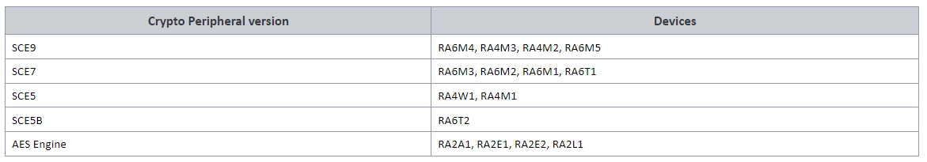
iii. Mbed Crypto HW Acceleration 3.5 HW overview
Notes:
In this session, I will go through the overview of recent FSP releases, new features released in FSP, features that are in development and planned features and finally the FSP roadmap.

Slide 31
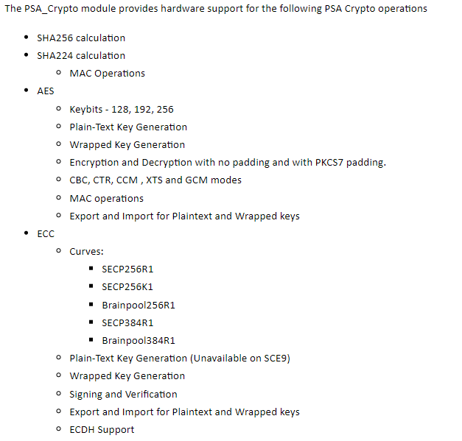
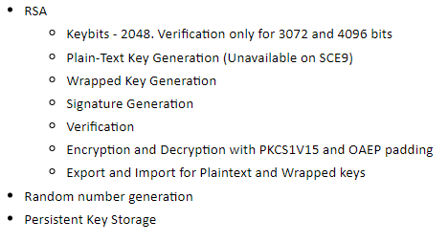
iii. Mbed Crypto HW Acceleration 3.5 Feature
Notes:
In this session, I will go through the overview of recent FSP releases, new features released in FSP, features that are in development and planned features and finally the FSP roadmap.

Slide 32
iii. Mbed Crypto HW Acceleration 3.5 configuration
Build Time Configurations for mbedCrypto: configurations are defined in arm/mbedtls/config.h
SHA256 Configuration:
To enable hardware acceleration for the SHA256/224 calculation, the macro MBEDTLS_SHA256_ALT and MBEDTLS_SHA256_PROCESS_ALT must be defined in the configuration file.
By default SHA256 is enabled. SHA256 can be disabled, but SHA512 then needs to be enabled (software version) because the PSA implementation uses it for the entropy accumulator.
AES Configuration:
To enable hardware acceleration for the AES128/256 operation, the macro MBEDTLS_AES_SETKEY_ENC_ALT, MBEDTLS_AES_SETKEY_DEC_ALT, MBEDTLS_AES_ENCRYPT_ALT and MBEDTLS_AES_DECRYPT_ALT must be defined in the configuration file.
By default AES is enabled. AES cannot be disabled because the PSA implementation requires it for the CTR_DRBG random number generator.
Plaintext key generation for AES XTS 128 bit operation is supported on SCE7 and SCE9. Additionally wrapped key 128 bit operation is supported on SCE9.
Notes:
In this session, I will go through the overview of recent FSP releases, new features released in FSP, features that are in development and planned features and finally the FSP roadmap.

Slide 33
iii. Mbed Crypto HW Acceleration 3.5 configuration
ECC Configuration:
To enable hardware acceleration for the ECC Key Generation operation, the macro MBEDTLS_ECP_ALT must be defined in the configuration file.
For ECDSA, the macros MBEDTLS_ECDSA_SIGN_ALT and MBEDTLS_ECDSA_VERIFY_ALT must be defined.
By default ECC, ECDSA and ECDHE are enabled. To disable ECC, undefine MBEDTLS_ECP_C, MBEDTLS_ECDSA_C and MBEDTLS_ECDH_C.
RSA Configuration:
To enable hardware acceleration for the RSA2048 operation, the macro MBEDTLS_RSA_ALT must be defined in the configuration file.
By default RSA is enabled. To disable RSA, undefine MBEDTLS_RSA_C, MBEDTLS_PK_C, MBEDTLS_PK_PARSE_C, MBEDTLS_PK_WRITE_C.
Notes:
In this session, I will go through the overview of recent FSP releases, new features released in FSP, features that are in development and planned features and finally the FSP roadmap.

Slide 34
iii. Mbed Crypto HW Acceleration 3.5 configuration
Wrapped Key Usage
To use the Secure Crypto Engine to generate and use wrapped keys, use PSA_KEY_TYPE_AES_WRAPPED or PSA_KEY_TYPE_ECC_KEY_PAIR_WRAPPED(curve) or PSA_KEY_TYPE_RSA_KEY_PAIR when setting the key type attribute.
Setting the key's type attribute using this value will cause the SCE to use wrapped key mode for all operations related to that key.
Note
On the SCE9 devices, only the RSA public key can be exported. A file system must be used to store the internally generated private key.
Persistent Key Storage
Persistent key storage can be enabled by defining MBEDTLS_FS_IO, MBEDTLS_PSA_CRYPTO_STORAGE_C, and MBEDTLS_PSA_ITS_FILE_C.
Platform Configuration
To run the mbedCrypto implementation of the PSA Crypto API on the MCU, the macro MBEDTLS_PLATFORM_SETUP_TEARDOWN_ALT must be defined in the configuration file. This enables code that will initialize the SCE. Parameter checking (General|MBEDTLS_CHECK_PARAMS) is enabled by default.
Random Number Configuration
To run the mbedCrypto implementation of the PSA Crypto API on the MCU, the macro MBEDTLS_ENTROPY_HARDWARE_ALT must be defined in the configuration file. This enables using the TRNG as an entropy source. None of the other cryptographic operations (even in software only mode) will work without this feature.

Slide 35
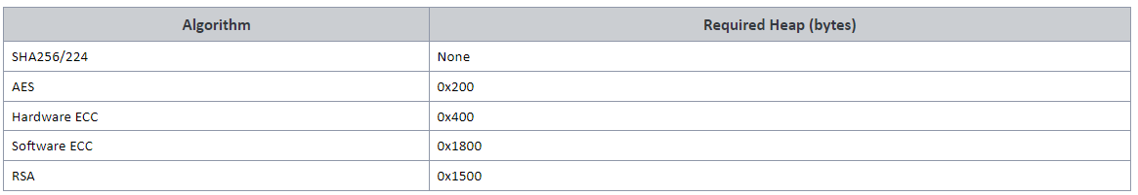
iii. Mbed Crypto HW Acceleration 3.5 usage note
Hardware Initialization: mbedtls_platform_setup() must be invoked before using the PSA Crypto API to ensure that the SCE peripheral is initialized.
Memory Usage: In general, depending on the mbedCrypto features being used a heap size of 0x1000 to 0x5000 bytes is required. The total allocated heap should be the sum of the heap requirements of the individual algorithms:
(A minimum stack of 0x1000 is required where the module is used. This is either the main stack in a bare metal application or the task stack of the task used for crypto operations.)
Limitations: Only little endian mode is supported.
SCE9 Usage: The crypto capabilities in this mode on the SCE9 are different which results in the below usage limitations with mbedCrypto:
The module includes both wrapped and plaintext keys code irrespective of whether the application requires it.
Plaintext key generation is not supported for RSA and ECC; only wrapped keys can be generated.
If ECDH is used, only wrapped key will be generated on SCE9 and will not return an error even if the user context is somehow set for plain key. This may be relevant only if the psa_key_agreement() function with plaintext key on SCE9 is attempted.

Slide 36
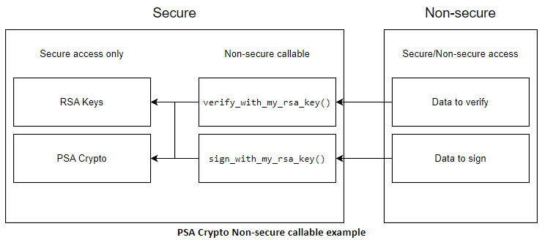
iii. Mbed Crypto HW Acceleration 3.5 usage note
Using PSA Crypto with TrustZone:
Unlike FSP drivers, PSA Crypto cannot be configured as Non-secure callable in the RA Configurator for a secure project. To achieve the security objective of controlling access to protected keys, both the PSA Crypto code as well as the keys must be placed in the secure region.
non-secure code to use the API by making it Non-secure callable will require the keys to be stored in non-secure memory.
Secure project
During secure project boot-up, psa_crypto_init() is called.
The RSA private key is programmed into secure flash either at the factory or by calling psa_generate_key() in persistent mode. Note that the data-flash area used by the LittleFS will have to be in the secure region if the key is generated as a persistent.
psa_import_key()/psa_open_key() are called with the resultant handle held in secure RAM.
The Non-secure callable section contains the following user-defined functions
verify_with_my_rsa_key(input_signature, input_hash, verification_result)
The implementation of this function in secure region will call psa_verify_hash() and return the result via verification_result.
sign_with_my_rsa_key(input_hash, output_signature)
The implementation of this function in secure region will call psa_sign_hash() and return the signature via output_signature.
Non-secure project
Calls verify_with_my_rsa_key() to verify a signature. The implementation will use the public key that is present in the secure project.
Calls sign_with_my_rsa_key() to generate a signature. The implementation will use the private key that is present on the secure project.

Slide 37
iii. Mbed Crypto HW Acceleration 3.6 AES Example
This is an example on using the PSA Crypto API to generate an AES256 key, encrypting and decrypting multi-block data and using PKCS7 padding. RA Flexible Software Package Documentation: Mbed Crypto HW Acceleration (rm_psa_crypto) (renesas.github.io)
Notes:
In this session, I will go through the overview of recent FSP releases, new features released in FSP, features that are in development and planned features and finally the FSP roadmap.

Slide 38
Iv. Secure Crypto Engine (r_sce_protected_cavp) 4.1 Overview
RA FSP Document: RA Flexible Software Package Documentation: Secure Crypto Engine (r_sce_protected_cavp) (renesas.github.io)
Driver for the CAVP Certified Secure Crypto Engine (SCE) on RA MCUs.
(CAVP: Cryptographic Algorithm Validation Program)
This module provides SCE CAVP Certified functions.
HW Overview: Obtained device certification with RA6M4.

Slide 39
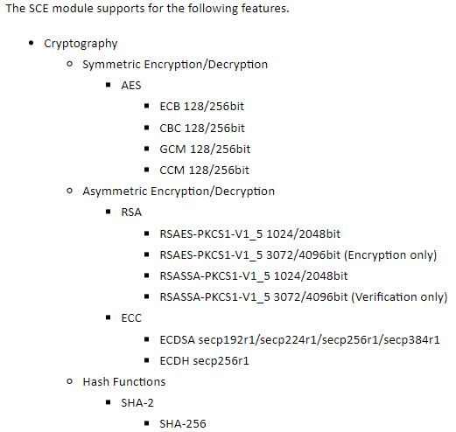
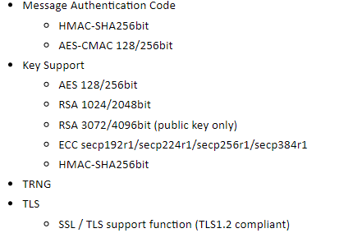
Iv. Secure Crypto Engine (r_sce_protected_cavp) 4.2 Feature

Slide 40
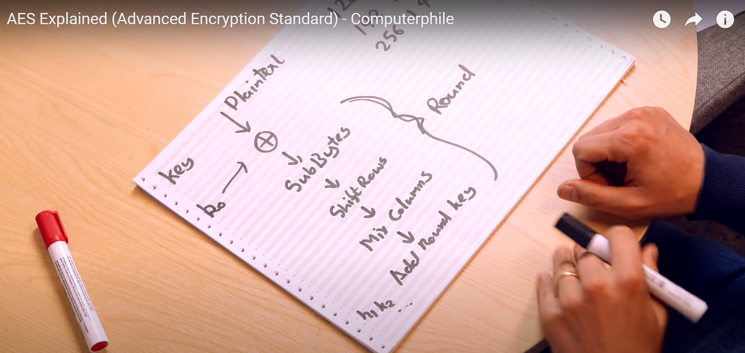

Slide 41
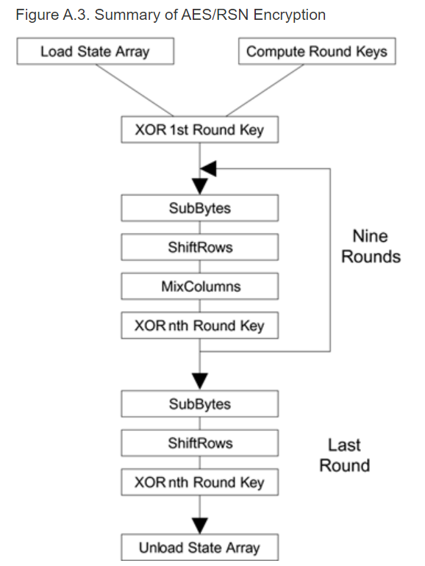
V. AES Algorithm
The AES specifies three key sizes: 128, 192, and 256 bits.
AES-GCM, AES-CCM are 128-bits symmetric block cipher. (128-bits: block size)
10 block:
SubBytes
ShiftRows
MixColumns
XorRoundKey
Reference:
Example code: RA Flexible Software Package Documentation: Mbed Crypto HW Acceleration (rm_psa_crypto) (renesas.github.io)
The AES Block Cipher – Coursera
(96) AES Explained (Advanced Encryption Standard) - Computerphile - YouTube

Slide 42
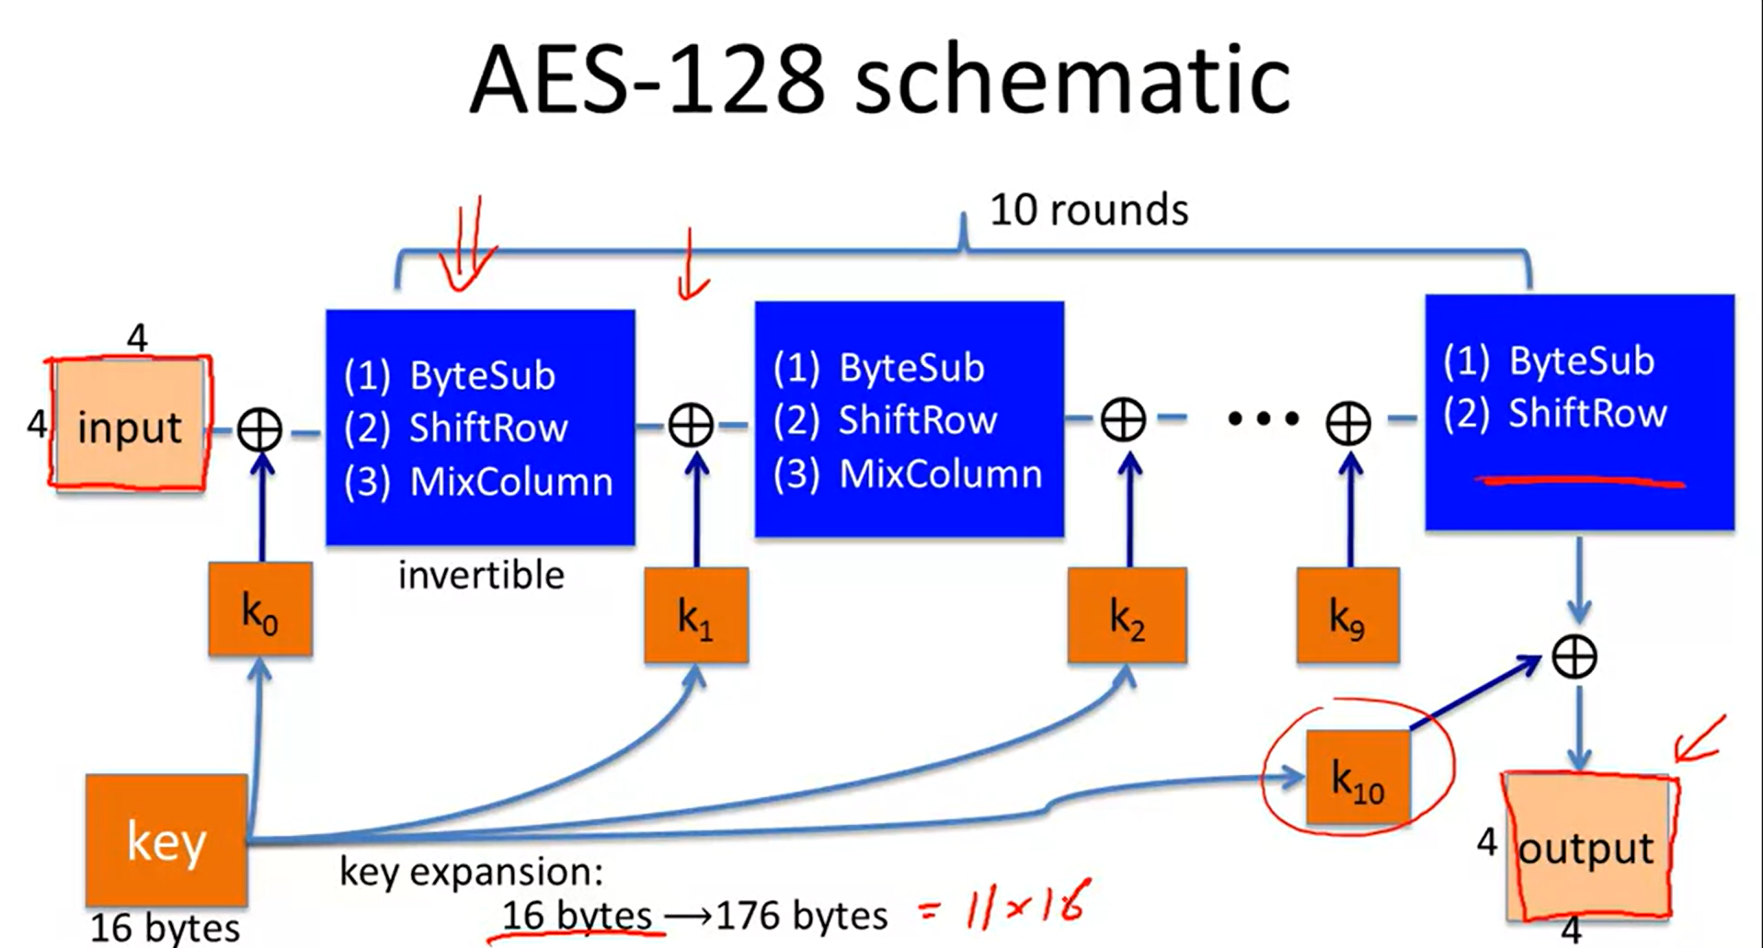
AES
AES is 128-bits symmetric block cipher. (128-bits: block size)

Slide 43
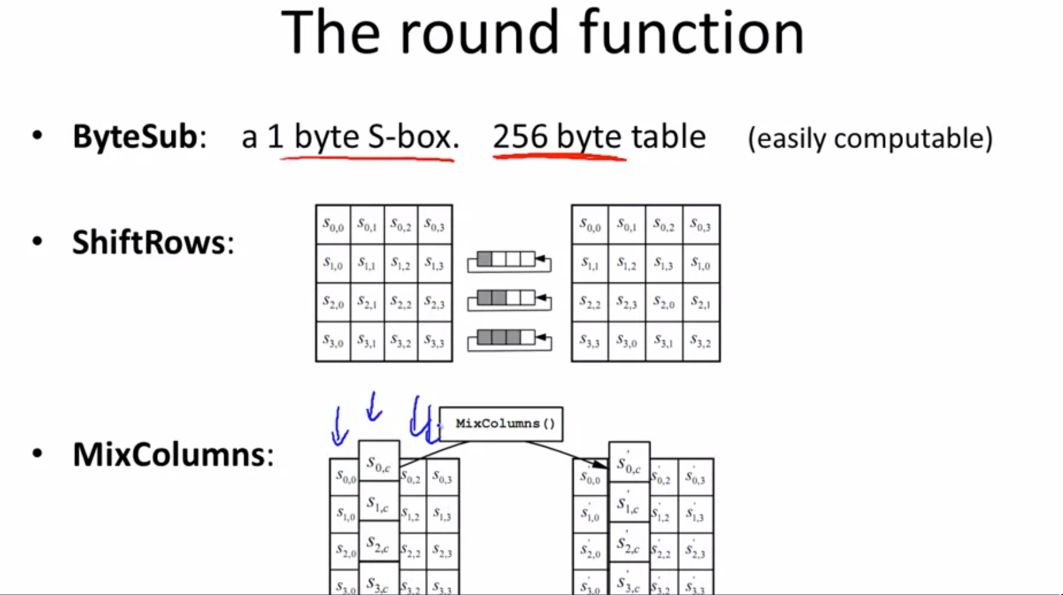
AES
AES is 128-bits symmetric block cipher. (128-bits: block size)
10 block:
SubBytes
ShiftRows
MixColumns
XorRoundKey
The AES Block Cipher – Coursera
(96) AES Explained (Advanced Encryption Standard) - Computerphile - YouTube

Slide 44
Renesas.com
Notes:
Thank you everyone for your great support. FSP is growing to the next level with lot of new features and new device supports. Also expanding beyond RA to other Renesas MCU and MPU families.. So thank you very much for your contributions!

